Slide 1

Node with Varying Values - tf.get_variable tf.keras.initializers tf.global_variables_initializer()

Slide 2
Reference
tf.keras.initializers
An Explanation of Xavier Initialization
Xavier and He Normal (He-et-al) Initialization
Youtube
Code

Slide 3
Define Node with Varying Values - tf.get_variable

Slide 4
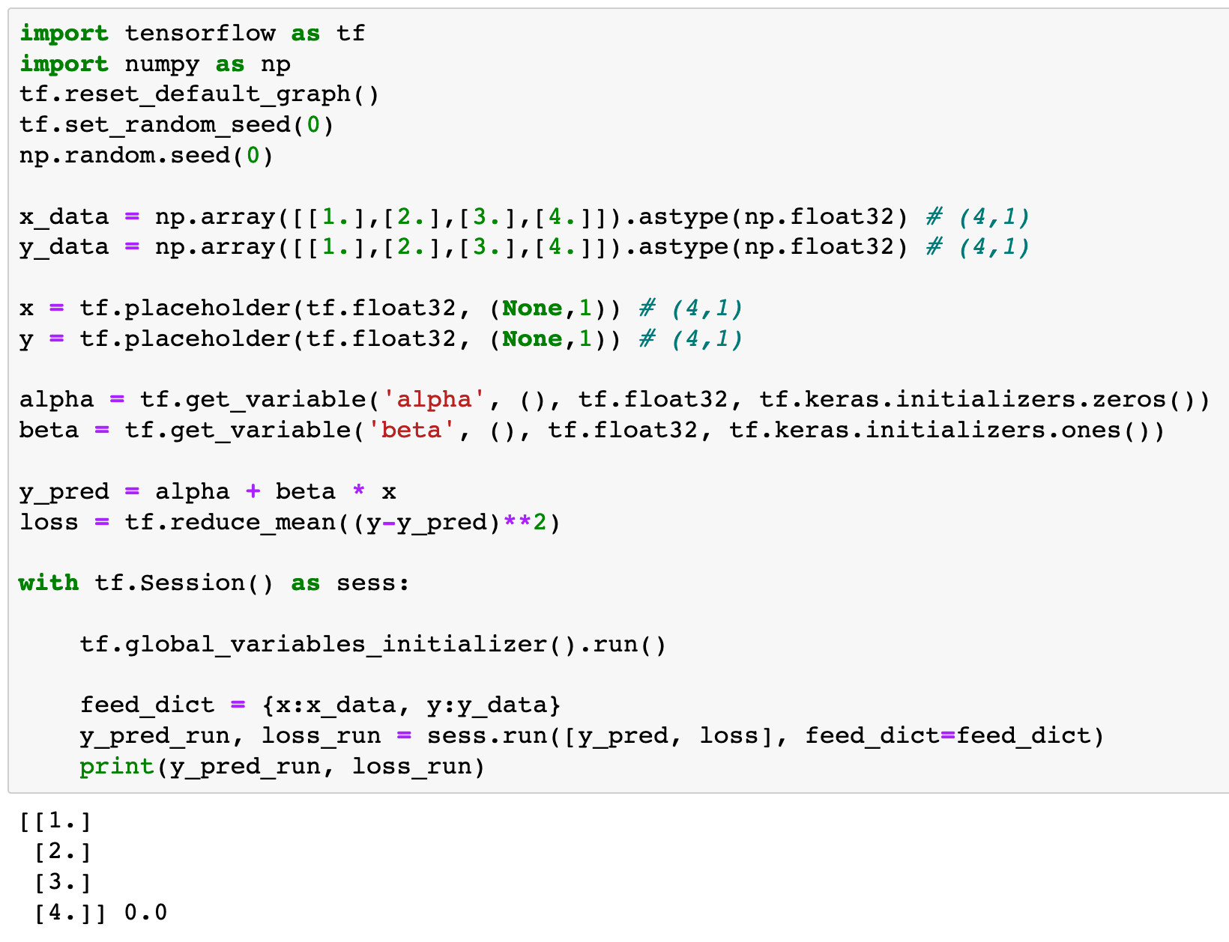

Slide 5
tf.get_variable

Slide 6
dtype
shape

Slide 7
shape
dtype

Slide 8
name

Slide 9
name
initializer

Slide 10
Initialize Node with Varying Values - tf.global_variables_initializer()

Slide 11
Initialize Node with Varying Values

Slide 12
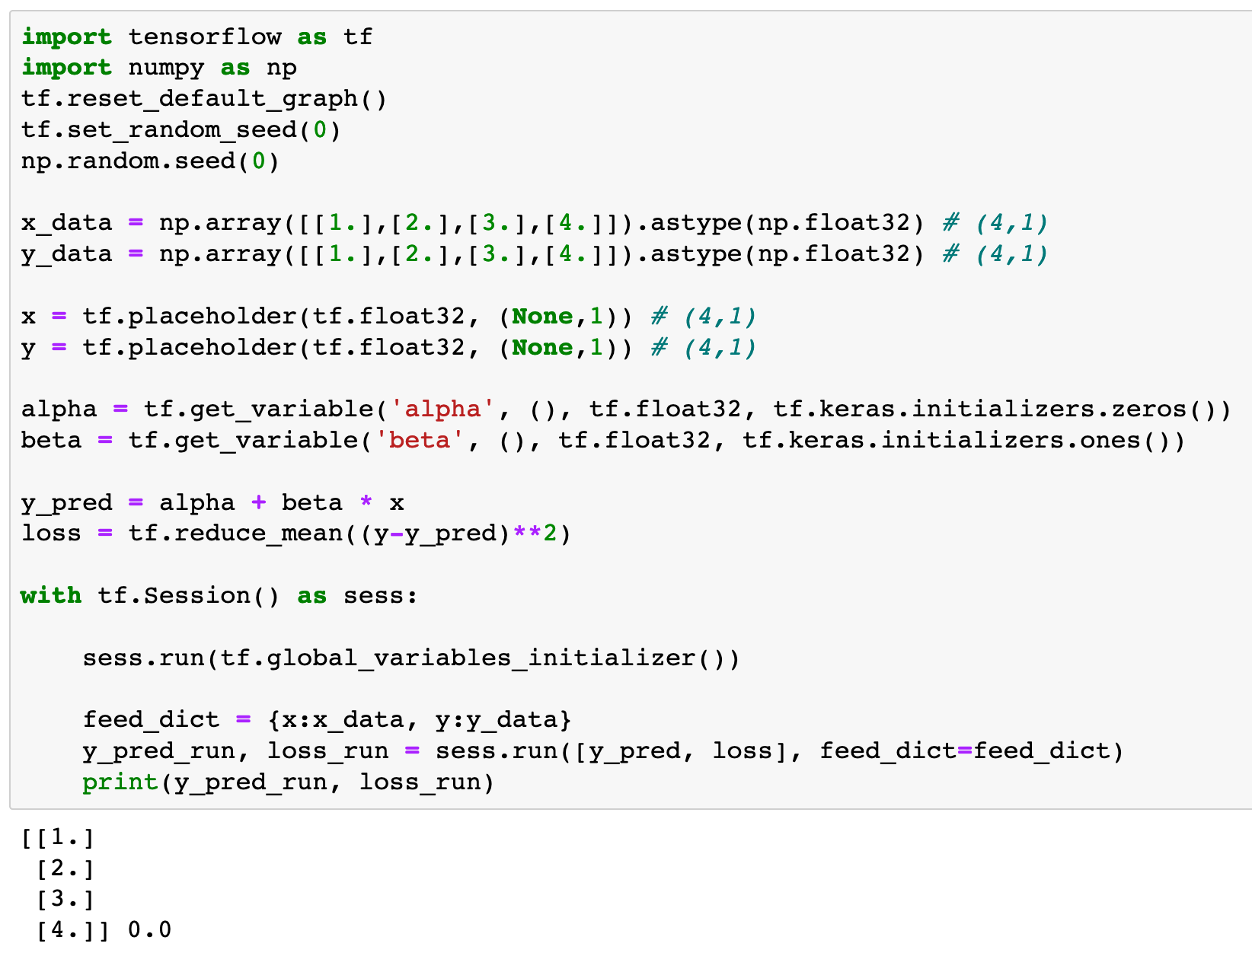
Initialize Node with Varying Values

Slide 13
Now
Let’s Play with Code

